Slide 1

Fulton County 2025 Retiree/Beneficiary Open Enrollment

Slide 2
Agenda
2025 Open Enrollment Updates
Open Enrollment
Tobacco-Use Attestation and Wellness Credit
2025 Benefit Information
Medical Plans
Dental Plans
Vision Plan
Life and Dependent Insurance
Next Steps

Slide 3
What’s New for 2025
Benefit Updates
Non-Medicare-Eligible Retirees/Beneficiaries
Tobacco Attestation and Wellness Credit for Non-Medicare-Eligible Retirees/Beneficiaries
Kaiser premiums are increasing by 8.9%
Tobacco-Use Attestation must be completed by November 1, if you are enrolling in medical coverage for 2025. If you do not complete the online attestation, you will pay a $25 biweekly tobacco-use surcharge starting January 1, 2025.
Aetna Basic MAPD premiums are increasing by 16.4%
Kaiser Senior Advantage premiums are increasing by 4.5%
ALL Retirees/Beneficiaries
Improved hearing aid benefits in the Anthem and Kaiser HMO plans, Kaiser Senior Advantage Plan, and Aetna Medicare Advantage and Part D (MAPD) plans
Aetna Dental PPO premiums are increasing by 3.1%
Medicare-Eligible Retirees/Beneficiaries
Aetna MAPD premiums are increasing by 19.4%
No changes to the Aetna Dental HMO premiums
Anthem premiums for the Medicare HMO, PPO Plus, and Indemnity plans are decreasing by 3.6%
Anthem premiums for the HSA, HMO, and POS medical plans are decreasing by 3.6%
Superior Vision will be replacing EyeMed as the Vision carrier. No changes to the Vision premiums
No changes to Basic Life or Dependent Life premiums
Wellness Credit for 2025 – Non-Medicare retirees can still reduce your 2025 premium under any of the medical plans by $20 each month ($240 per year). Complete ALL the Anthem or Kaiser requirements by December 31, 2024, to earn/keep your $240 wellness credit.
Open Enrollment: October 14 – November 1, 2024

Slide 4
Open Enrollment…What do I need to turn in?
ALL Retirees/Beneficiaries
Only if making changes:
Submit a completed 2025 Retiree Enrollment Form if you want to make changes to your coverage—do NOT submit a form if you do not want to make changes.
If adding a new dependent, submit supporting documentation
We highly recommend that you email your enrollment form and any other required documents.
Non-Medicare Retirees/Beneficiaries:
Complete and return the Tobacco-Use Attestation form. You have to submit this form even if you’re not making changes to your coverage for 2025, or you will be assessed a $50 monthly tobacco use surcharge starting January 1, 2025.
Medicare Retirees/Beneficiaries:
Return the Part B Affidavit to receive the subsidy in 2025
Here’s how you can provide your completed form(s) to the Retiree Benefits Office:
Email: retireebenefits@fultoncountyga.gov
Mail: Fulton County Retiree Benefits Office
141 Pryor Street SW, Suite 7001
Atlanta, GA 30303

Slide 5
Non-Medicare-Eligible Retirees, Beneficiaries and Dependents Medical Plans Anthem HSA Anthem POS Anthem HMO Kaiser HMO

Slide 6



Choosing and using your Fulton County Anthem health plan
Notes:
Greetings, my name is Brittney Thomas, and I am Fulton County’s dedicated Anthem Account Specialist. Today we will provide a summary of the Anthem health plans and well-being resources available to use as an active Fulton County employee.

Slide 7


New for 2025!
Introducing Total Health Connections
With a dedicated advocate in your corner, healthcare is easier at every step
Total Health Connections is about making sure you and your family experience healthcare in a way that helps you feel confident, covered, and protected. With Total Health Connections, you have your own personal health champion, called a family advocate. Your dedicated family advocate is here to help you and your family through unexpected emergencies and everyday health needs. They stay one step ahead, helping you get the care and support you need today and down the road — at no extra cost to you.
Here’s how you’ll benefit:
A dedicated family advocate
Your family advocate is here to connect you with the right care at the right time with proactive, inclusive, and compassionate support. They can help you:
◦ Find top-quality doctors, specialists, and care facilities in your health plan and help schedule appointments.
◦ Stay on top of preventive care and manage chronic conditions.
◦ Understand your health plan and all the benefits available to you from your employer.
◦ Quickly get preapprovals for urgent medical needs, like surgery.
◦ Connect with our in-house clinical experts. These experts work with you and your doctor to create a personal care plan that supports your overall wellness and ongoing health needs.
Helping you and your family feel confident and protected
Notes:
Your health plan now comes with an extra layer of support. Total Health Connections is here to improve the way you experience healthcare by making it easier to use your benefits and protect your health. This new program pairs you with a Family Advocate, who is your own personal health champion. They’ll help you and your family get the care you deserve when you’re dealing with health concerns, no matter how big or small. Count on them to stay one step ahead, even as your life changes and health needs evolve. With Total Health Connections, your dedicated family advocate is in your corner. They connect the dots across your unique benefits to ensure you have a simple, guided, and personalized healthcare experience.

Slide 8




24/7 Nurse Line
Connect with a registered nurse who can:
Answer health questions.
Help you decide where to go for care.
Find doctors or other care healthcare professionals near you.
Support anytime, day or night
Emotional Well being ​Resources
Learn effective ways to manage:
Stress
Depression
Anxiety
Sleep Issues
Building Healthy Families
Building Healthy Families
Screenings, tools, and trackers — for preconception, fertility, pregnancy, and early childhood.
Extensive content library covering topics to support diverse families — including single parents and same-sex or multicultural couples — on the path to parenthood.
Notes:
You also have access to the following:
-24/7 Nurse Line
You can connect with a registered nurse who will answer your health questions anytime, day or night. They can help you decide where to go for care and find doctors and other care providers in your area.
-Building Healthy Families is Anthem’s next-generation maternal health program. It offers a complete end-to-end family creation program that recognizes every individual’s and/or family’s unique path to parenthood and supports them throughout each phase (pre-conception, maternity, parenthood) of their journey.
-EWBR uses cognitive behavioral therapy to help you through life’s hurdles. The self-paced programs use a comprehensive assessment to provide a snapshot of areas that you may be struggling in. From this, you may choose programs best suited to your needs. Through this program, you may select a family member or friend to be a teammate and help you with accountability or reassurance when you need it most!

Slide 9

How the Anthem HSA Plan Works
Start here!
No charge to you for in-network preventive care
Your Annual Deductible Responsibility
Annual Out-of-Pocket Maximum
Fulton County HSA contribution:
Single: $750
Family: $1,500
Optional retiree/beneficiary HSA contribution
You pay 100% of first-dollar charges up to annual deductible. Use HSA money to cover these expenses.
Once you meet the deductible, you pay 10% of the cost for most covered in-network services. Use HSA money to cover these expenses.
Plan pays 100% of covered charges after you reach the annual out-of-pocket maximum.
HSA Contributions
Coinsurance
Use Anthem’s online Care and Cost Finder tool to model your potential costs

Slide 10

How does the MetLife Health Savings Account work with my High Deductible Health Plan
Notes:
First of all….who is qualified to enroll in an HSA?
–– You need to be covered under the <Enter Plan Name>as of the first day of the month in which the HSA is established.
–– Not covered by any other health plan that is not a High Deductible Health Plan (including Tricare).
–– Not enrolled in Medicare benefits.
–– Not claimed as a dependent on another person’s tax return.

Slide 11
How does the MetLife Health Savings Account work with my High Deductible Health Plan
Notes:
Keep in mind not only do you have up to 30% more purchasing power with pre-tax money but contributing to an HSA lowers your taxable income too.
HSA savings can earn interest. The current annual percentage rates of interest can be viewed online in your account. MetLife’s interest rate on HSA cash savings is 2-3X the industry average. You can see more details in the Participant Portal.
Once your HSA cash account balance reaches <$2000>, you can transfer funds above that amount into an HSA investment account. You can choose from a selection of mutual funds and setup an investment allocation model for future transfers like you would for a 401k plan.

Slide 12
MetLife Health Savings Account
Notes:
This slide shows just a few of the qualified expenses under the HSA…such as hospital expenses, dental and vision and even medical insurance premiums for members over the age of 65.
The portal has more examples of qualified expenses or to see the full list you can log onto the IRS website and look at publication 502.

Slide 13
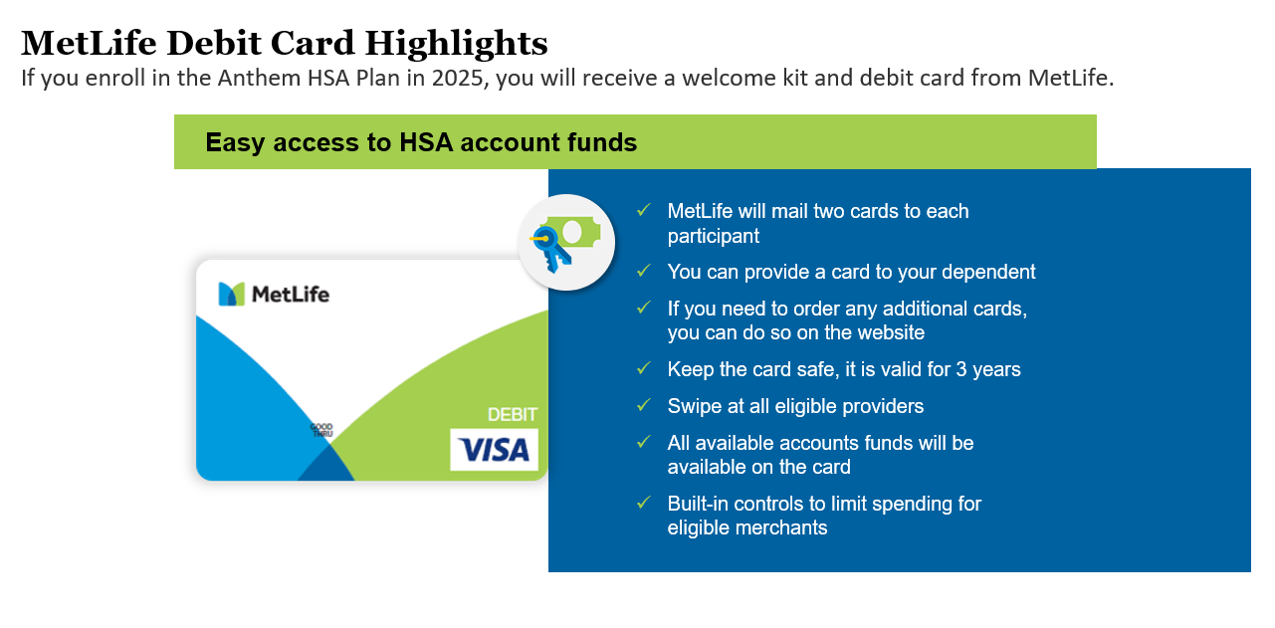

Notes:
Once you are enrolled you will receive an envelope with 2 debit cards. They will arrive in a white envelope with the MetLife name.
Additional cards can be ordered thru the portal. The cost is $5.00 for every 2 cards. These cards are good for 3 years so keep them safe!
Be sure to keep your receipts for your Health Care FSA expenses. Unlike an HSA, the IRS requires that all transactions be substantiated, so keep them in a safe place and we will communicate to you if a receipt is needed. You can simply upload directly to the participant portal.

Slide 14
How the Anthem POS Plan Works
Start here!
No charge to you for in-network preventive care
Annual Deductible:
Single: $500
REE + 1: $750
Family: $1,000
If you go in-network, you pay copays (e.g., doctor’s office visit, urgent care visit). Copays are separate and don’t count toward, the annual deductible.
Your Annual Deductible Responsibility
Annual Out-of-Pocket Maximum
Some services are covered through coinsurance after you meet the annual deductible (e.g., outpatient treatment and hospital services).
Once you meet the annual deductible, you pay 20% of the cost for most in-network services until you reach the annual out-of-pocket maximum.
The plan pays 100% of covered charges once you reach the annual out-of-pocket maximum.
Your copays, deductible and coinsurance are accumulate towards the out-of-pocket maximum.
Pay Your Copays
Coinsurance

Slide 15
How the Anthem HMO Plan Works
Start here!
No charge to you for in-network preventive care. No PCP referrals needed!
Pay Your Copays
Plan pays 100% of covered charges once you reach the annual out-of-pocket maximum.
You must see Anthem providers; otherwise, no benefits paid except for emergencies.
You pay applicable copays for services (e.g., doctor’s office visit, urgent care visit, hospital visit). Plan pays 100% of covered charges after the applicable copay.
See Anthem Providers
Annual Out-of-Pocket Maximum

Slide 16
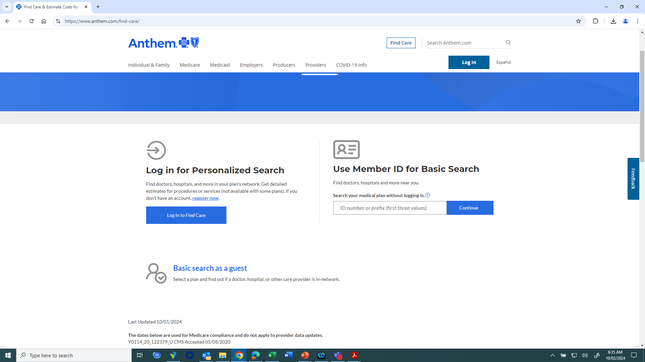
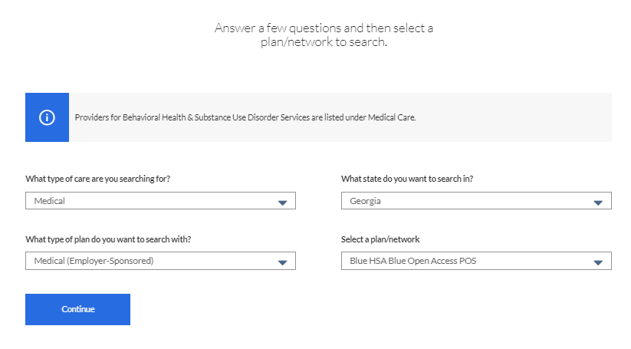
How to Locate an Anthem Network Doctor
Go to anthem.com/find-care
To search as a member: Use your member ID card number or log in with a username and password
Once you’re logged in, the search will automatically include doctors and other providers in your plan
Enter the search categories based on what you need and click Search
To search as a guest: Select Basic search as a guest
Select the best answers from each drop-down menu
Select a plan/network (Blue Open Access HMO, Blue Open Access POS, or Blue HSA Open Access POS) and click Continue
Select the best answers for the next set of fields and click Search

Slide 17

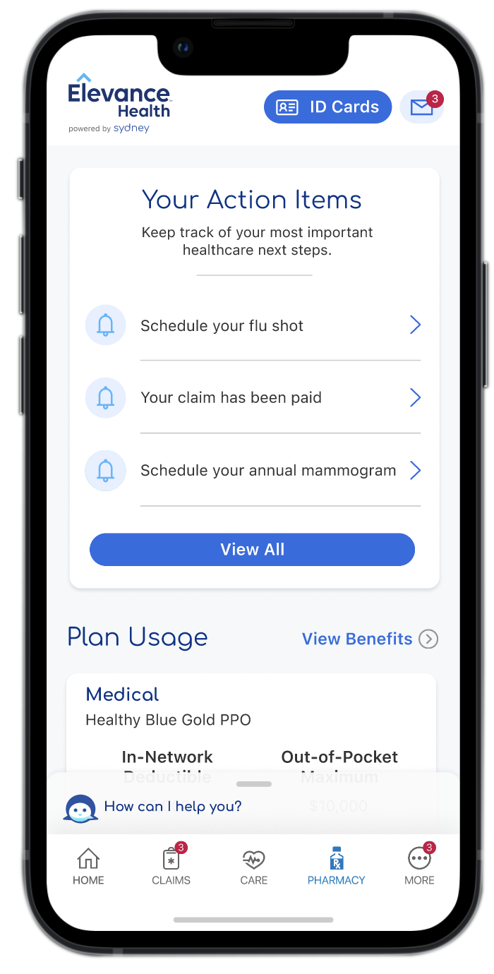
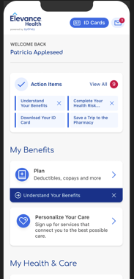
Sydney Health mobile app
Makes healthcare easier
Sydney Health helps you keep track of your health and benefits all in one place. You can use the app to:
Find care and compare costs.
Learn what’s covered and check claims.
View and use your digital ID cards.
Check your plan usage.
Fill prescriptions.
Chat with Member Services if you have questions or need information.
Access Virtual Care to talk with a doctor via chat or a video session.
Use the Symptom Checker to assess your symptoms.
Use My Health Dashboard to find wellness tips and personalized action plans.
Connect with Community Resources to find no-cost and reduced-cost programs.
Simplify your family’s health data with My Health Record to access and share health information in one place.
Sydney Health is offered through an arrangement with Carelon Digital Platforms, a separate company offering mobile application services on behalf of your health plan.
17
Notes:
So all aforementioned programs are of course accessible through our award winning Sydney Health mobile app. This app keeps your healthcare information in one place and enables you to manage your care conveniently from the palm of your hand.

Slide 18



Benefits of Using Health Care
Anthem and health care provider Grady Health System together offer you access to high-quality health services at no cost to you.*
Inpatient services, including hospitalizations and inpatient testing
Outpatient services, including doctor visits and outpatient treatment
Neighborhood health centers for visits to Grady’s neighborhood clinics
Grady is one of the largest public hospital systems in the Southeast and is a world-renowned teaching hospital.
Staffed with doctors from Emory University and Morehouse Schools of Medicine—two of the most prestigious medical teaching institutions in the U.S.
*If you enroll in the Anthem HSA Plan and use Grady Health System providers, services will be covered at 100% after you meet the deductible.
Notes:
There’s more! Anthem & Grady partner to bring you quality care at an affordable price point. These services are normally rendered at no cost to the member unless you elect coverage under the HSA plan. Under this plan, you will be subject to meeting your deductible before you are eligible to receive services covered at 100%.

Slide 19


2025 Open enrollment period presentation for Fulton County
Sonja Ford, Medicare Group Account Manager| 2024
Desiree Press, Associate Account Manager
Keia Legree, Executive Account Manger

Slide 20









Integrated care centered around you
KAISER PERMANENTE MEDICARE HEALTH PLANS
Primary care
Quality care begins with our integrated care delivery system, which offers you:
Care and coverage together in one package
A coordinated, connected care team
Many convenient services under one roof
Health
plan
Specialty care
Digital
care options
Pharmacy and labs
Connected care team
Electronic health data

Slide 21





KAISER PERMANENTE MEDICARE HEALTH PLANS
Your care, your way
With Kaiser Permanente, you can get care when, where, and how you want it.
Video Visits
Connect with your doctor online. It’s convenient, safe, and secure, and it often doesn’t require a copay.
In person Same-day appointments
may be available.
Phone
Schedule a telephone appointment and get advice 24/7.
Email
Message your doctor anytime with
nonurgent questions.
App
Download our app to schedule appointments, manage prescriptions,
see test results, and more.

Slide 22
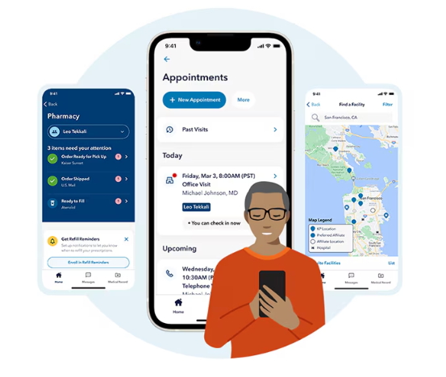


Care that’s convenient
We make it easy to get high-quality care when and where you
want it. No matter how you connect, you’ll always talk with a medical professional who can see your health history, so you never have to repeat your story.
Your health at your fingertips
Get 24/7 care by phone or video.¹
Email your care team.
Schedule routine appointments.
View most lab results and doctor’s notes.
Refill most prescriptions.
Check in for appointments.
Pay bills and view statements.
Simplify your health care with the Kaiser Permanente app.
Over half of members
avoided a trip to the ER
or urgent care with a video visit.²
1. When appropriate and available. 2. Kaiser Permanente internal data, 2023.
Notes:
What to say:
When you need care, you can talk to a clinician in person, through email, over the phone or by video.¹
Visit us in person at a location near you. <Same-day, next-day, and weekend appointments> are available at most locations.
Schedule a phone or video visit with a doctor or clinician.
Get 24/7 care advice by phone or online, without an appointment.
Get personalized care advice for certain conditions online, including some prescriptions and many lab tests.
Access your care from anywhere with the Kaiser Permanente app.
When you use telehealth services at Kaiser Permanente, you’re connecting with health care professionals who can see your health record and pick up where you left off. And most of our telehealth services are covered at no additional cost.²
[Optional copy to field audience questions about phone appointments or video visits] Your doctor can advise you about whether a phone or video visit would be an option for your care. For example, a video visit may be an option for a dermatology appointment but not if you need an in-person exam.
FOOTNOTES
1. When appropriate and available. If you travel out of state, phone appointments and video visits may not be available in select states due to licensing laws. Laws differ by state.
2. High deductible health plans may require a copay or coinsurance for phone and video visits.

Slide 23
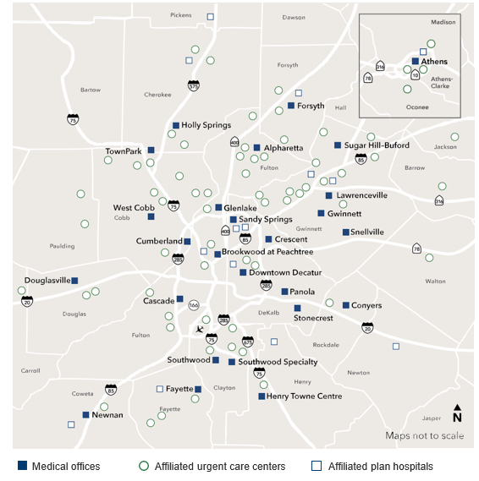

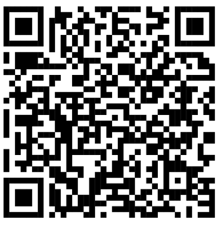
Conveniently located throughout metro Atlanta
A BETTER WAY TO TAKE CARE OF BUSINESS
Choose from
26 Kaiser Permanente medical offices
3 locations for 24/7 urgent care
60+ affiliated community urgent care centers
18 affiliated hospitals
700+ doctors throughout metro Atlanta and Athens
Collaborating with
Find locations that are close to home.

Slide 24



Resources for mental health
Members can get help with depression, anxiety, addiction, and mental or emotional health — without a referral for mental health care within Kaiser Permanente. Share your concerns with anyone on your care team at any time, and they can connect you to the support you need.
Individual or group therapy
Health classes¹
Medication
Online resources
Apps for mental wellness and self-care²
Not sure where to start? Talk to your personal doctor about your concerns or call us to talk with our mental health team.
Find mental health and wellness resources that fit your life.
1. Some classes may require a fee. 2. The apps and services described above are not covered under your health plan benefits, are not a Medicare-covered benefit, and are not subject to the terms set forth in your Evidence of Coverage or other plan documents. The apps and services may be discontinued at any time.
| ©2025 Kaiser Foundation Health Plan, Inc.
Notes:
What to say:
“Care for all that is you” means care for your total well-being — not just your physical health. What you think, feel, and do affects your whole health. We’re committed to caring for all that is you — so you can achieve optimal health in mind, body, and spirit.
Kaiser Permanente provides clinical and support services for a wide range of conditions, including:
Anxiety
Stress
Depression
Addiction
Autism spectrum disorders
Our mental health team includes psychiatrists and psychologists, as well as marriage and family therapists, addiction medicine physicians, and medical social workers.
You don’t need a referral for mental health care within Kaiser Permanente.
Practice self-care with popular apps to reduce stress, improve sleep, and manage overall mental wellness.

Slide 25






Convenient care while traveling
Planning a trip? Have a child going away to college? Before you leave, we’ll help you get vaccinated, refill prescriptions, and stay on top of your health while you’re away.
You’re covered for urgent and emergency care anywhere in the world.
You can always get 24/7 care by phone or online across the U.S.*
Get urgent care at a Cigna PPO Network*, MinuteClinic® or Concentra urgent care center when you’re traveling outside a Kaiser Permanente area.
Learn more about getting
care away from home.
24/7 Away from Home Travel Line: 951-268-3900* or kp.org/travel
*When appropriate and available. If you travel out of state, phone appointments and video visits may not be available in select states due
to licensing laws. Laws differ by state.

Slide 26
The Kaiser Permanente Plan
Early Retiree

Slide 27
The Kaiser Permanente Plan
This table shows an example of some of your benefits.
Annual deductible | $0 individual / $0 family
Annual out-of-pocket max | $6,450 individual / $12,900 family
Covered service | You pay
Primary Care | $25 co-pay
Specialty Care | $40 co-pay
Outpatient surgery | $150 co-pay
Urgent Care | $50 co-pay
Emergency department visit (co-pay waived if admitted) | $150 co-pay
Ambulance services (per trip) | 100% covered
*This is a summary of some benefits and their co-pays. For specific information about your covered health plan benefits, limitations, and exclusions, including those not listed in this summary, please see your Summary Plan Description.
Notes:
Now let’s take a look at some key benefit and associated co-pays. Your annual deductible is $0 for you and your family. Your Annual out of pocket maximum is $3000 for an individual and $6,000 for a family, meaning those are the maximum dollar amounts you or your family would be responsible for paying out of pocket in a plan year. A few other key benefits to call out…… (read out benefits & co-pays). Again, all benefits on the Kaiser Permanente plan are based on co-pays only.

Slide 28
The Kaiser Permanente Plan
This table shows an example of some of your benefits.
Covered service | You pay
X-rays and lab tests | $0 copay
Routine preventive physical exams | $0 copay
Well-child preventative care visits (0-24 months) | $0 copay
Scheduled prenatal care visits and first postpartum visit | $0 copay
Hearing Aid – Benefit Enhancement | Prior - $1,000/12 months 2025 - $3,000/36 months
*This is a summary of some benefits and their copays. For specific information about your covered health plan benefits, limitations, and exclusions, including those not listed in this summary, please see your Summary Plan Description.
Notes:
We’d also like to point out a number of benefits available to you at $0 copay….. (read out covered services)

Slide 29
The Kaiser Permanente Plan
This table shows an example of some of your benefits.
Covered service | You pay
Prescription drug coverage (up to a 30-day supply) | Tier 1 - $10 copay (generic) Tier 2 - $30 copay (preferred brand) Tier 3 - $50 copay (non-preferred brand) Tier 4 - $75 copay (specialty)
Mail Order drug coverage (up to 90-day supply) | Tier 1 - $20 copay (generic) Tier 2 - $60 copay (preferred brand) Tier 3 - $100 copay (non-preferred brand) Tier 4 - $150 copay (specialty)
Note: To see where your current medications fall within our formulary, visit kp.org/formulary and choose “2024 Five-Tier formulary plan”. If the cost to receive your medication has increased, Kaiser Permanente pharmacy consultants are available to help you find a lower cost alternative.
*This is a summary of some benefits and their copays. For specific information about your covered health plan benefits, limitations, and exclusions, including those not listed in this summary, please see your Summary Plan Description.
Notes:
Now let’s take a look at your pharmacy copays. With the Kaiser Permanente plan, our formulary is broken out into 5 tiers. Tier 1 drugs are preventative generic, Tier 2 drugs are preferred generic, Tier 3 drugs are preferred brand, Tier 4 drugs are Non-preferred and Tier 5 drugs are specialty. With mail order, you can receive a 90 days supply sent to your home and you save a bit of money on a 3-month supply.

Slide 30
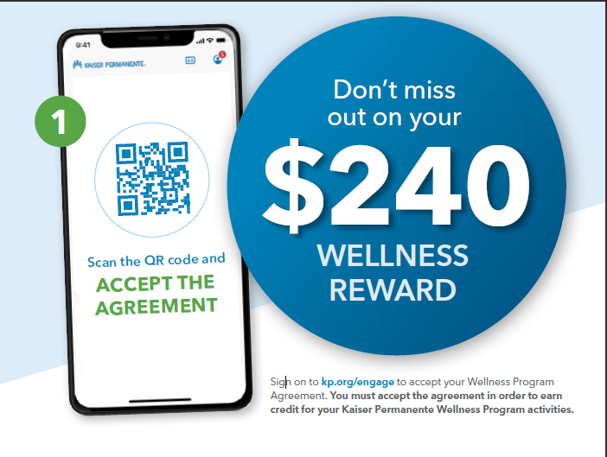

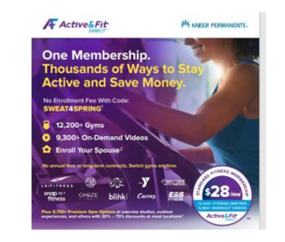



Resources for everyday wellness
ClassPass workouts
Get moving with fitness options that fit your schedule and lifestyle, including Pilates, dance, , cardio, and yoga.
Headspace Care
One-on-one emotional support coaching by text, self-care activities, and more — available 24/7.
Complete activities by December 31, 2024
Calm app
Calm uses meditation and mindfulness to help lower stress, reduce anxiety, and improve sleep quality.
Active & Fit Direct members pay $28 per month (plus one-time $28 enrollment fee) for access to a national network of more than 10,000 fitness centers

Slide 31

Thank you

Slide 32
Comparing Medical Plans
 |  | Anthem HSA |  | Anthem POS |  | Anthem HMO | Kaiser HMO
 |  | In- Network | Out-of-Network | In-Network | Out-of-Network | In-Network Only | In-Network Only
County-Provided HSA Contribution |  | Single: $750 EE +1 / Family: $1,500 |  | Not available |  | Not available | Not available
Annual Deductible | Single | $1,800 | $3,600 | $500 | $1,000 | No deductible | No deductible
 | EE + 1 | $3,600 | $7,200 | $750 | $1,500
 | Family | $3,600 | $7,200 | $1,000 | $2,000
Office Visit |  | 10% after deductible | 40% after deductible | PCP: $30 Specialist: $50 | 40% after deductible | PCP: $25 Specialist: $40 | PCP: $25 Specialist: $40
Emergency Room (waived if admitted) |  | 10% after deductible | 10% after deductible | $200 copay | $200 copay | $150 copay | $150 copay
Urgent Care |  | 10% after deductible | 40% after deductible | $50 copay | 40% after deductible | $50 copay (designated facilities) | $50 copay (designated facilities)
Inpatient Hospital |  | 10% after deductible | 40% after deductible | 20% after deductible | 40% after deductible | $250 copay | $250 copay
Outpatient Hospital |  | 10% after deductible | 40% after deductible | 20% after deductible | 40% after deductible | $150 copay | $150 copay
Note: If you are enrolled in the Anthem HMO or POS Plan and use Grady Health System providers, no deductibles, copays or coinsurance payments are required. If you are enrolled in the Anthem HSA Plan and use Grady Health System providers, services will be covered at 100% after you have met the deductible.

Slide 33

Comparing Prescription Drug Coverage
 | Anthem HSA |  | Anthem POS |  | Anthem HMO | Kaiser HMO
 | In- Network | Out-of-Network | In-Network | Out-of-Network | In-Network Only | In-Network Only
Retail (up to a 30-day supply)
Generic | 10% after deductible | 40% after deductible | $10 copay | 40% after deductible | $10 copay | $10 copay
Preferred Brand | 10% after deductible | 40% after deductible | $35 copay | 40% after deductible | $30 copay | $30 copay
Non-Preferred Brand | 10% after deductible | 40% after deductible | $60 copay | 40% after deductible | $50 copay | $50 copay
Specialty | 10% after deductible | 40% after deductible | $100 copay | 40% after deductible | $75 copay | $75 copay
Mail Order (31- to 90-day supply)
Generic | 10% after deductible | N/A | $20 copay | N/A | $20 copay | $20 copay
Preferred Brand | 10% after deductible | N/A | $60 copay | N/A | $60 copay | $60 copay
Non-Preferred Brand | 10% after deductible | N/A | $100 copay | N/A | $100 copay | $100 copay

Slide 34
Medicare-Eligible Retirees, Beneficiaries and Dependents Aetna Basic Medicare Aetna Enhanced Medicare Aetna Medicare Advantage Anthem Medicare HMO Anthem Medicare PPO Plus Kaiser Senior Advantage

Slide 35
Medicare Part B Premium Subsidy
Medicare-eligible retirees/beneficiaries can receive a 50% Part B premium subsidy from the County if they meet the requirements.
Retirees/beneficiaries who are Medicare-eligible MUST certify Medicare Part B coverage ANNUALLY by completing the Part B Affidavit, enclosed in your retiree enrollment kit. Completed affidavits, along with a copy of your Medicare card, must be returned to the Fulton County Pension Office, postmarked by November 01, 2024.
If you do not return the Part B Affidavit along with a copy of your Medicare card annually, you will lose the Part B premium subsidy!

Slide 36
Medical Plan Options for Medicare-Eligible Retirees/Beneficiaries
Current options continue for 2025
Aetna Basic Medicare Advantage Plan with prescription drug coverage
Includes coverage for all Medicare Part A and Part B benefits (hospital services, doctor visits and outpatient care), plus additional benefits, all in one plan—with no deductible
Aetna Enhanced Medicare Advantage Plan with prescription drug coverage
Highest level of benefits: Plan pays 100% for all covered services
Lower rates than Anthem Medicare Indemnity Plan
If you enroll in this plan, you will pay the premium difference between this plan and the Aetna Basic Medicare Advantage Plan
Anthem Medicare HMO Plan
This plan supplements benefits paid by Medicare.
Your care MUST be provided by or referred by your-in-network primary care physician; otherwise, the plan does not pay benefits (except in an emergency)
Anthem Medicare Indemnity Plan
Anthem PPO Plus Plan (no new enrollees)
Kaiser Senior Advantage Plan
The plan shares the cost of covered services immediately —there’s no deductible.
Once you hit the out-of-pocket maximum, the plan covers the full cost of services

Slide 37


Aetna Medicare Advantage

Slide 38
Let’s look at your medical benefits
 | Aetna MedicareSM Plan (PPO)
 | Base Plan | Enhanced Plan
Annual deductible | $0 deductible | $0 deductible
Annual out-of-pocket maximum | $1,000 out-of-pocket maximum | $0 out-of-pocket maximum
Preventive care | $0 copay | $0 copay
Primary care office visit | $15 copay | $0 copay
Specialty care office visit | $15 copay | $0 copay
Inpatient hospital | $120 copay | $0 copay
Outpatient surgery | $60 copay | $0 copay
Emergency room | $65 copay | $0 copay
Ambulance | $0 copay | $0 copay
Physical therapy | $15 copay | $0 copay

Slide 39
Prescription drug benefits designed for Fulton County Retirees

Slide 40
Let’s look at your prescription drug benefits
 | Aetna® Part D plan
Pharmacy network | P1
Formulary | Classic Plus
Deductible | None
Tier 1 | $10 copay
Tier 2 | $25 copay
Tier 3 | $45 copay
Tier 4 | $60 copay
Catastrophic phase | $0
Mail-order drugs | 1.5 – 2 times retail cost share for a 90-day supply
Maximum out of pocket (MOOP) | $2,000

Slide 41

CVS Caremark® Mail Service Pharmacy
The prescriptions you fill regularly are conveniently delivered to your door within 10 days after processing your order.
Two easy steps to get started:
See if your medication is available through mail order.
Check your plan formulary (drug list) or call the number on your member ID card.
Choose how to sign up:
Register online through your member website.
Call Member Services at the number on your member ID card.

Slide 42
Inflation Reduction Act (IRA)
The Inflation Reduction Act (IRA) provides enhancements and changes to Medicare Part D plans. The program makes improvements to Medicare to make most Part D plans richer than they are today, reducing member cost share.
Effective January 1, 2025, key aspects of the IRA include:
A $2,000 per member annual out-of-pocket limit compared to the $8,000 true out-of-pocket (TrOOP) cost threshold currently in place for 2024.
A new Medicare Prescription Payment which may be beneficial if you have $500 or more in monthly Part D drug costs. The plan works by letting you spread out payments monthly instead of paying in full at the pharmacy or for mail order.
Refer to your Renewal Package for more details.

Slide 43
Need help with your Medicare drug costs?
Extra Help is a Medicare program that helps pay some Medicare prescription drug costs such as:
To see if you qualify call:
"BeneLynk"
1-888-715-0225 (TTY: 711),
Monday through Friday, 9 AM to 6 PM ET
or
Social Security
1-800-772-1213 (TTY: 1-800-325-0778),
Monday through Friday, 8 AM to 7 PM local time
Monthly plan premium
Yearly deductible
Coinsurance
Copays

Slide 44

You get more with Aetna Medicare Advantage

Slide 45
Discover wellness
Healthy Home Visits
Get a home visit from a licensed doctor or nurse to assess your health and safety needs.
Hearing and Vision reimbursements
$2,000 per ear reimbursement every 36 months on hearing aids.
$200 reimbursement every 24 months on eyewear.
Healthy Rewards program
Earn gift cards when you complete important health and wellness activities.
24-hour Nurse Line
You have toll-free, 24-hour access to nurses who can help answer your health questions.
Wellness

Slide 46
Discover wellness
SilverSneakers® fitness program Join any participating location nationwide or take online classes at home. Use Apple Fitness+℠ on your iPhone® to enjoy access to workouts from anywhere, anytime. At no extra additional cost to you!
Nonemergency transportation
Access up to 24 one-way rides for nonemergency transportation to your medical appointments.
Teladoc Health®
Connect with a Teladoc Health primary care provider 24/7 by web, phone or mobile app from home, for nonemergency medical needs.
Wellness

Slide 47
Support to make life easier
Resources For Living®
A Resources For Living life consultant can connect you with a wide-range of cost-effective and reliable services in your area.
Aetna Compassionate CareSM
Helps with treatment and decision support to members, families and caregivers for advanced illnesses.
Healthwise® Knowledgebase
Discover online tools and resources to help you live healthier and manage your conditions.
Support

Slide 48
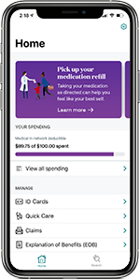

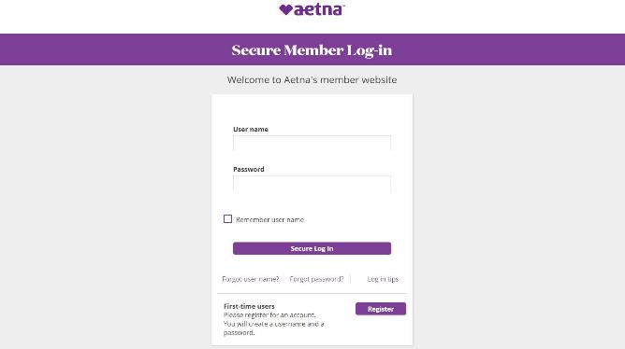
Aetna® Medicare member website
Use our secure member website to:
Connect with care
Find walk-in clinics
Search for a PCP
View provider ratings and reviews
Manage your benefits
View plan details
See progress toward your deductible
Access your digital ID card
Review your claims
Receive your Medical EOB statement
Get detailed cost breakdown of claims
Stay healthy
Take a health assessment
Try health coaching
Start a wellness program
Get treatment options
You can also manage your benefits right from your phone with the Aetna HealthSM app.
AetnaRetireePlans.com
Log in or register for an account using your member ID.

Slide 49


Hearing Benefit Overview
Members can apply $2,000/ear benefit toward eligible hearing aids every 36 months
Concierge services by dedicated hearing Member Experience Advisors
Access to a nationwide network of thousands of locations
Annual hearing exam at no charge
Robust choice of hearing aids from all 10 major manufacturers at 6 levels of technology
Transparent pricing and a 60-day, 100% money-back guarantee
Three follow-up visits at no charge
First set of earmolds (as required)
3 years of batteries included*
3-year manufacturer’s repair warranty, including one-time replacement coverage for lost, stolen or damaged hearing aids**
12- and 18-month financing options available with 0% APR for qualified applicants
*Not applicable to the purchase of rechargeable hearing aid models.
**Deductibles may apply.
Source: Incident Hearing Loss and Subsequent Comorbidity: a Longitudinal Administrative Claims Study
©2024 NationsBenefits, LLC. All rights reserved. Other marks are the property of their respective owners.
49
©2024 NationsBenefits, LLC. All rights reserved. Other marks are the property of their respective owners.

Slide 50












The Member Experience
​​Member contacts Nations. Nations will explain the benefit and schedule a hearing exam with a local provider on the member’s behalf.
Member visits provider for a hearing exam and hearing aid evaluation at no charge.
​​If the member is a candidate for hearing aids, the provider will make recommendations and order hearing aids, utilizing the member’s benefit allowance.
The provider programs and fits the member with their hearing aids.
​​The member receives a 60-day evaluation period, 3 follow-up visits, and a 3-year comprehensive warranty to ensure quality of care and total satisfaction.
Industry leading selection of devices from 10 hearing aid manufacturers:
Source: Incident Hearing Loss and Subsequent Comorbidity: a Longitudinal Administrative Claims Study
©2024 NationsBenefits, LLC. All rights reserved. Other marks are the property of their respective owners.
50
©2024 NationsBenefits, LLC. All rights reserved. Other marks are the property of their respective owners.

Slide 51



12/6/23
Contact NationsHearing:
Call: 877-225-0137
Online: Nationshearing.com/Aetna

Slide 52

Thank you

Slide 53
Claims Adjudication for Medicare-Eligible Retirees/Beneficiaries
Medical claims adjudication assumes Part B enrollment.
For the purposes of the calculation and adjudication of benefits, even if you have not enrolled in Medicare Part B, the claims administrator (Anthem) will calculate benefits as if you had enrolled.
The 2025 Part B premium will be published later this year. At that time, those enrolled in Part B will receive their 2025 renewal premium notification in the mail, and new enrollees can determine their Part B premium and any late-enrollment penalty, if applicable.
To avoid the late-enrollment premium penalty and the potential increased claims liability, you are encouraged to enroll in Medicare Part B when you first become eligible.

Slide 54
Medicare Indemnity (PPO)
 | Anthem Medicare Indemnity Plan (In and Out of Network Benefits)
Annual deductible | Retiree: $100 Family: $200
Annual out- of-pocket maximum | None
Preventive care | 100% covered after Medicare
Emergency room services | 100% covered after Medicare
Doctor’s office visit | 100% covered after Medicare
Ambulance | 100% covered after Medicare
Outpatient office visit | 100% covered after Medicare
Inpatient office visit | 100% covered after Medicare
Lab, x-ray and other diagnostic tests | 100% covered after Medicare
Skilled nursing facility | 100% covered after Medicare
Home health care | 100% covered after Medicare
Hearing aid benefit | 100% covered after deductible

Slide 55
Medicare HMO
 | Anthem Medicare HMO Plan (In-Network Only)
Annual deductible | None
Annual out- of-pocket maximum | Retiree: $7,350 Family: $14,700
Preventive care | 100% covered
Emergency room services | $90 copay
Doctor’s office visit | $25 copay
Ambulance | 100% covered
Outpatient office visit | $120 copay, max. of $500
Inpatient office visit | $120 copay, max. of $500
Lab, x-ray and other diagnostic tests | 100% covered
Skilled nursing facility | 100% covered, up to 120 days per calendar year
Home health care | 100% covered, up to 120 days per calendar year
Hearing aid benefit | $4,000 for up to two devices, every 36 months

Slide 56





Discount Programs
Notes:
Anthe members can save money on certain services. We discounts on Lasik surgery, eyewear, hearing care, dental, and so much more. Additionally, Active&Fit direct is also offered to Anthem members allowing them access to thousands of gyms for just a $28 registration and a $28 monthly fee afterward. For a short time, members can take advantage of a $0 enrollment fee.

Slide 57
Sonja Ford Kaiser Permanente Medicare Specialist
Kaiser Permanente Senior Advantage

Slide 58
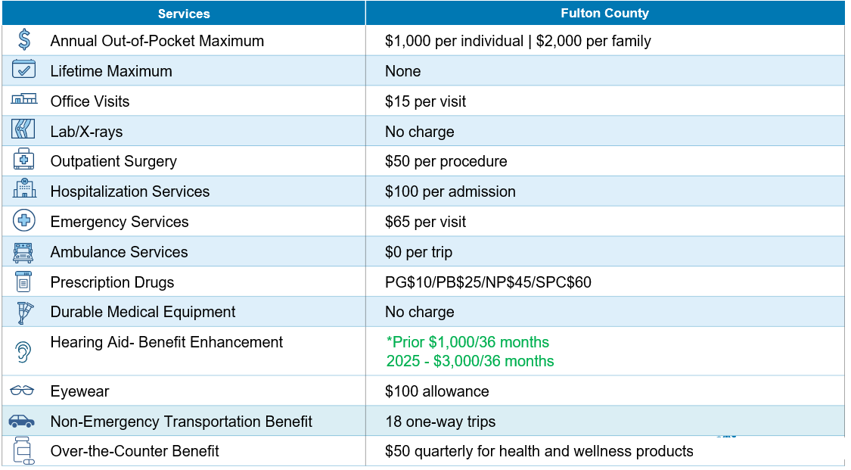
Summary of Benefits 01/01/2025-12/31/2025
KAISER PERMANENTE MEDICARE HEALTH PLANS

Slide 59

More Ways to Live Healthy
Kaiser Permanente offers additional resources to our members, including:
1
Vision Benefits
3
Over-The-Counter Health & Wellness Benefit
2
OnePass Fitness Benefit
4
Non-Emergency Transportation Benefit
z

Slide 60


Take advantage of OnePass®
OnePass Fitness Program
KAISER PERMANENTE MEDICARE HEALTH PLANS
One Pass can help you find a fitness routine that’s right for you, whether you work out at home or at the gym — and it’s available at no extra cost.
At the gym
Choose from the largest nationwide gym network of fitness locations (included in the Core and Premium networks).
At home
Work out at home with live, digital fitness classes or on-demand workouts.
With new friends
Join a group class or find local clubs and social events that match your interests.

Slide 61

Need a ride to the doctor? Your plan covers that
KAISER PERMANENTE MEDICARE HEALTH PLANS
Transportation benefits
You can get a ride to and from your doctor visits at no charge.*
You can get a ride for:
Doctor appointments
Medical services, such as labs or X-rays
Picking up medications or medical equipment
Types of transportation available:
Taxi or other private transportation
(can accommodate wheelchairs and walkers that collapse
and fit into the trunk)
Wheelchair van available for those who are unable to sit in a private vehicle for the duration of the ride
*Your plan covers up to 18 one-way trips (50 miles per trip) per calendar year.

Slide 62


KAISER PERMANENTE MEDICARE HEALTH PLANS
More ways to save
$50 quarterly benefit that can be used to purchase OTC health and wellness products.
You can use your allowance to purchase:
First aid supplies
Cough, cold, and allergy medicine
Incontinence products
And more
Two easy ways to order:
By computer
By phone

Slide 63

Dental Plans

Slide 64

Aetna Dental
AETNA DENTAL HMO (DHMO/DMO) PLAN
Requires you to see in-network dentists; no out-of-network benefits paid except for emergencies
You must select a primary dentist before being seen.
If you live in one of the following states you are NOT ELIGIBLE to enroll in the DHMO/DMO plan: Alaska, Alabama, Florida, Louisiana, Maine, Mississippi, Montana, North Dakota, New Hampshire, Puerto Rico, South Carolina, South Dakota, Vermont or Wyoming.
AETNA DENTAL PPO (DPPO) PLAN
Choose in- or out-of-network providers
If you go in-network, you do not need to complete a claim form
If you go out-of-network, you are responsible for paying the difference in cost if your dentist charges more than Aetna’s preapproved network fees; you may be required to pay the entire cost at the time of treatment and submit a claim for reimbursement

Slide 65
Comparing the Dental Plans
Plan Features | Aetna Dental HMO Plan | Aetna Dental PPO Plan
Deductible | None | Single: $50 Family: Up to $150
Preventive Services​ -cleanings, x-rays​ | 100% covered | 100%* covered
Basic Services​ -simple fillings, root canals​ | 100% covered | 15%*
Major Services​ -dentures, anesthesia | 40% | 50%*
Annual Benefit Maximum | None | $1,500 per person
Orthodontia Services | $1,500 copay; two years of treatment plus two years of follow-up | Deductible: $50 per person Lifetime maximum: $1,500 per person
*Out-of-network services will be covered based on the reasonable and customary charge, which is the normal amount charged by most dental providers in your geographic region, as determined by Aetna. If you go out-of-network for care, you will be responsible for your coinsurance plus any amount over the reasonable and customary charge.

Slide 66
Comparison – Aetna Dental HMO Plan vs. Aetna Dental PPO Plan
Plan Features | Dental HMO | Dental PPO
Retiree/beneficiary monthly contributions | Lowest | Highest
Benefits paid out-of-network | No | Yes
Size of the provider network | Smaller Generally made up of group practices with multiple providers in single location and multiple locations​ | Larger Generally individual private offices with 1 or 2 providers and a single location​
Must use primary dentist for care and referrals | Yes | No
Deductible | No | Yes

Slide 67
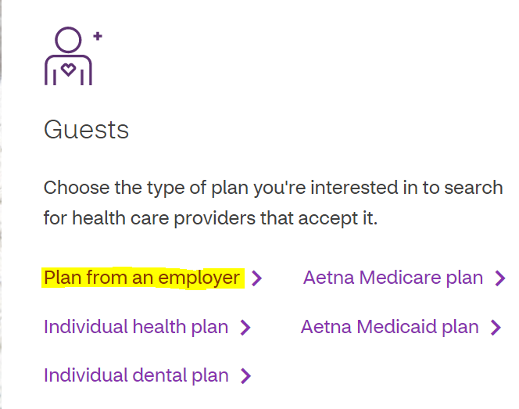
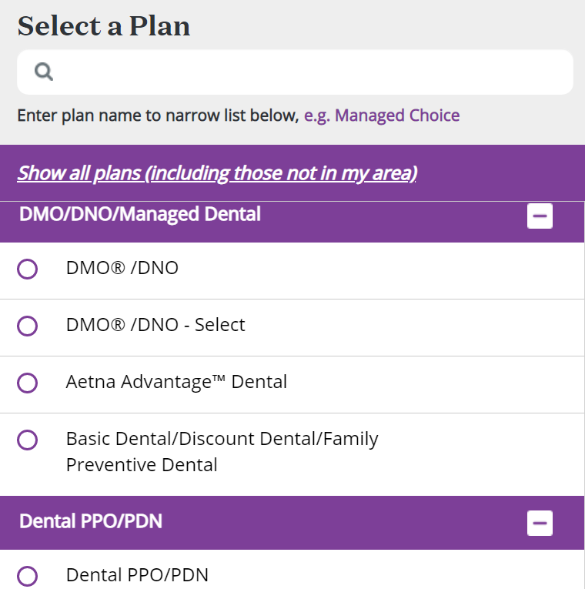
How to Locate an Aetna Network Dental Provider
Go to https://www.aetna.com/individuals-families/find-a-doctor.html.
To search as a guest: Select Guests
Select Plan from an employer
Enter your location
Select a Plan (DMO/DNO or Dental PPO/PDN)
Find what you need by Category Dentists

Slide 68
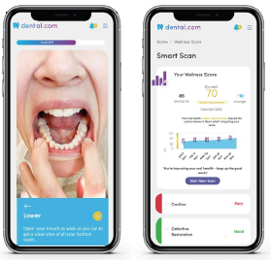
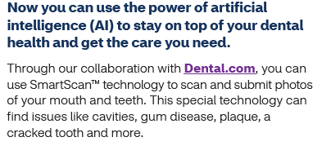
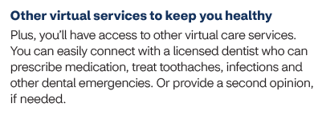
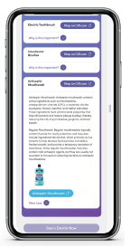
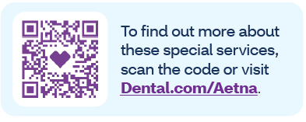
Aetna Virtual Dental Care
Aetna virtual dental care through Dental.com; 365 days a year

Slide 69
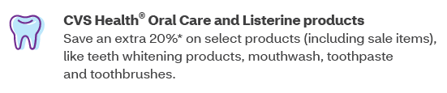
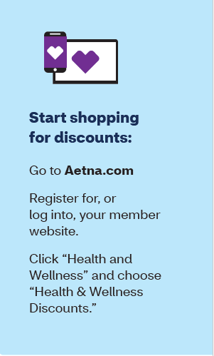



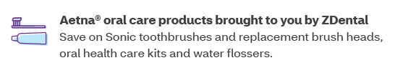

Special Discounts for Aetna Dental Members

Slide 70

Vision Plan

Slide 71

Superior Vision...savings, choice and convenience
In-network benefits for a wide range of covered services,^{V10} including eye exams, glasses and contact lenses
Discounts on lens enhancement options^{V11} and laser vision correction^{V12}
Free hearing exam and a discount of 40% off the national average for hearing aids^{V13}
Option to see any licensed ophthalmologists, optometrists and opticians at participating retail and private practice locations^{V14}
The top 50 retailers in-network, including America’s Best Contacts & Eyeglasses, Costco Optical, Eyeglass World, LensCrafters, Pearle Vision, Target Optical, VisionWorks, Walmart and more^{V15}
Popular online in-network eyewear stores, including Glasses.com, ContactsDirect, 1 800 contacts and Befitting
Out-of-network coverage
Your actual savings from enrolling in the Superior Vision Plan will depend on various factors, including plan premiums, number of visits to an eye care professional by your family per year and the cost of services and materials received. Be sure to review the Schedule of Benefits for your plan's specific benefits and other important details.
Actual costs and benefits may vary based upon plan design selected. Exclusions and limitations may apply. Please see your certificate for details on benefits and exclusions.
Notes:
Your Superior Vision vison plan was designed with you and your family in mind – you get eye care benefits for a wide range of covered services. Not only does it help you keep up with routine vision care visits, you get coverage for glasses, contacts … and even discounts on laser vision correction, a free hearing exam and a discount of 40% off the national average for hearing aids.
As a commitment to your overall vision care, Superior Vision provides discounts on lens enhancement options including, but not limited to, polycarbonate, UV coating, scratch-resistant coating and blue light filtering.*
With this plan, you have the option to see any licensed ophthalmologists, optometrists and opticians at participating retail and private practice locations.
The top 50 retailers in-network, including America’s Best Contacts & Eyeglasses, Costco Optical, Eyeglass World, LensCrafters, Pearle Vision, Target Optical, VisionWorks, Walmart and more
To locate a network provider in your area, visit metlife.com and click on “Find an Eye Care Professional”.
And, you can also shop online in-network eyewear stores, including Glasses.com, ContactsDirect, 1 800 contacts and Befitting.com.
*Not all providers participate in vision program discounts, including the member out-of-pocket features. Members are urged to contact their provider prior to scheduling an appointment to confirm if the discount and member out-of-pocket features are offered at that location. Discounts and member out-of-pocket are not insurance and subject to change without notice.

Slide 72




Benefit Type | In-Network Coverage | Out-of-Network Reimbursement | Frequency
Eye Examination (one per frequency) Comprehensive exam of visual functions and prescriptive corrective eyewear | Covered after a $0 copay | Covered up to $50 allowance | Every 12 months
Materials/Eyewear (either glasses or contacts allowed per frequency) | $0 copay | Up to $100 | Every 12 months
Standard Corrective Lenses Single vision Lined bifocal Lined trifocal Lenticular | Covered after materials copay | Covered up to: $40 allowance $60 allowance $80 allowance $100 allowance | Every 12 months
Notes:
Now, let’s talk specifics. Let’s look at your company’s plan design for your vision coverage. This simple chart gives you the facts and shows how you receive benefits whether you visit a in or out-of-network vision provider for services.
Whether or not you decide to visit a network provider, your employer has designed a plan that provides a level of coverage for routine eye exams. This way, your coverage benefits every member of your family – even those who don’t wear glasses or contacts at all.
As you can see, you will pay a nominal copay for in-network services including exams and eyewear. When you visit an out-of-network provider, you are responsible for any copay amounts and a portion of the costs for these services. You will typically pay for the full cost of the treatment at the time of service, then submit a claim form for reimbursement from Superior Vision.

Slide 73
Benefit Type | In-Network Coverage | Out-of-Network Reimbursement | Frequency
Standard Lens Options^{V3} Standard Polycarbonate (child up to age 18) | $40 copay | Applied to the allowance for the applicable corrective lens | Every 12 months
Progressive | Covered at lined trifocal level | $100 allowance | Every 12 months
Standard Polycarbonate (adult) Ultraviolet Coating Scratch-resistant Coating Tints Anti-reflective Coating Photochromic Blue Light Filtering Digital Single Vision Polarized Lenses High Index Lenses | These lens enhancements are available with maximum member out of pocket (MOOP) amount | Applied to the allowance for the applicable corrective lens | Every 12 months
Frame Allowance (20% off the balance when a frame choice exceeds the allowance. Available from all in-network private practice providers.) |  |  | Every 12 months
Notes:
Now let’s take a look at the other options covered by your plan. Lens options can improve the appearance, durability and/or function of your glasses. For example:
Ultraviolet Coating. This is a treatment that is applied to lenses to filter out harmful rays of the sun. It is recommended that glasses block 100% of both UVA and UVB rays to minimize eye damage from the sun’s rays.
Polycarbonate lenses. A lens material that is thinner, lighter, and more impact resistant than standard plastic. Polycarbonate lenses are the standard for children’s eyewear.
Progressive lenses. These lenses can be either bi-focal or multi-focal lenses with no visible lines where the lens power gradually changes from distance to near.
Scratch-resistant coating. This is a film or coating that protects lenses from scratching.
Anti-reflective coating. This is a lens treatment for your glasses that helps to reduce distracting glare and eye fatigue by reducing the amount of light reflecting off the lens surface and making the lenses appear clearer. Your eyes will also be more visible behind the lenses.
Photochromic. This refers to lenses that automatically change from clear to dark in the presence of ultraviolet (UV) radiation.
Your coverage also includes a frame allowance of up to [$100] after the eyewear copay I mentioned earlier. Your allowance is up to [$70] at out-of-network providers and [$55] if you visit a Costco retailer.
Additionally, when you visit an in-network private practice provider and the frames you choose exceed the benefit allowance, you get 20% off the amount that exceeds your allowance.

Slide 74
Benefit Type | In-Network Coverage | Out-of-Network Reimbursement | Frequency
Contact Lenses Fitting and Evaluation* | $200 retail allowance after a | Up to $160 | Every 12 months
Necessary | Covered in full | Covered up to $210 allowance | Every 12 months
Additional Lens Enhancements Additional Discounts on Glasses and Sunglasses Laser Vision Correction Hearing Discounts | Average 20-25% savings on all other lens enhancements 20% savings on additional pairs of prescription glasses and nonprescription sunglasses, including lens enhancements. Savings of 40% - 50% off the national average price of traditional LASIK are available at over 1,000 locations across our nationwide network of laser vision correction providers. A National Hearing Network of hearing care professionals, featuring Your Hearing Network, offers Superior Vision members discounts on services, hearing aids and accessories. These discounts should be verified prior to service.
*Standard contact lens fitting applies to a current contact lens user who wears disposable, daily wear, or extended wear lenses only. Premium contact lens fitting applies to new contact wearers and/or a member who wear toric, gas permeable, or multi-focal lenses.
Notes:
Your plan also includes coverage for contact lenses – including the initial fitting and evaluation. A lens fitting will help to find the most appropriate contact lens for your optimal comfort and vision.
You’ll receive a coverage allowance up to [$100]. Out-of-network charges will be higher.
In addition, the plan includes discount for additional pairs of prescription glasses and non-prescription sunglasses so that every member of your family can benefit.
You’ll even be eligible for savings of 40% - 50% off the national average price of traditional LASIK are available at over 1,000 locations across our nationwide network of laser vision correction providers. Contact QualSight LASIK at (877) 201-3602 for more information.

Slide 75
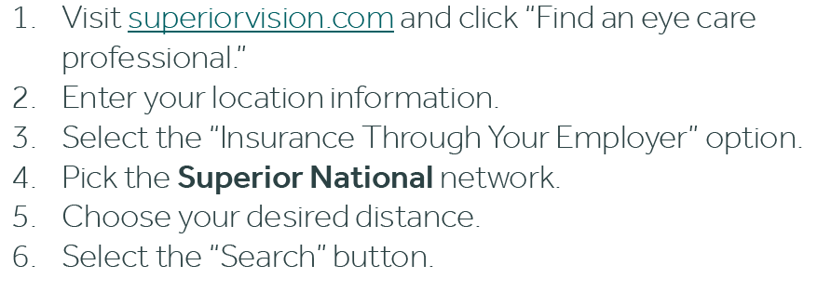
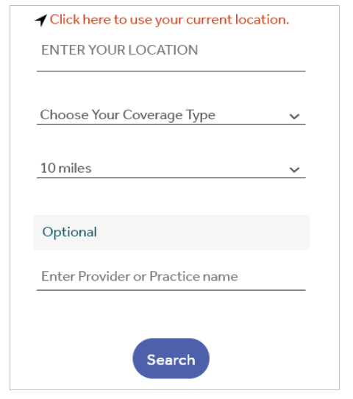
Locate a Vision Provider
With Superior Vision insurance, you can choose from thousands of private practice optometrists and ophthalmologists nationwide, as well as many large retail chain stores . You can find the names, addresses, languages spoken and phone numbers of participating vision providers by searching our online Find an Eye Care Professional directory.
Step 1:
Go to superiorvision.com
Step 2:
Select “Find an eye care professional”
Step 3:
"Choose your network*.“
Enter your Zip, City or State and select the “Find a Find A Vision Provider” button. You will then be prompted to select your plan from the list. The plan name is located in your Schedule of Benefits.
Notes:
With your Superior Vision plan, you can choose from thousands of private practice optometrists and ophthalmologists nationwide, as well as many large retail chain stores.
You can find the names, addresses, languages spoken and phone numbers of in-network providers by searching our online Find an Eye Care Professional directory.
(Click)You can find an eye care profession by going to superiorvision.com or clicking on the link in the slide.
(Click) Step 2 select Find an Eye Care Professional (Click)
(Click) Step 3 You will then be able to search for a vision provider by Zip Code, City or State (Click) Select the “Insurance Through Your Employer” option. (Click) Pick the Superior National network. (Click) Choose your desired distance (radius) then Select the “Search” Button (Click).

Slide 76

Life Insurance

Slide 77

Life Insurance
Basic Life Insurance
Fulton County provides you with Basic Term Life Insurance coverage
Dependent Spouse and Child Life Insurance
Dependents coverage $10,000 each
Children are covered until age 26 (unless disabled)

Slide 78

Questions?
Contact us: 404-612-7600, Option #1 retireebenefits@fultoncountyga.gov

